Slide 1
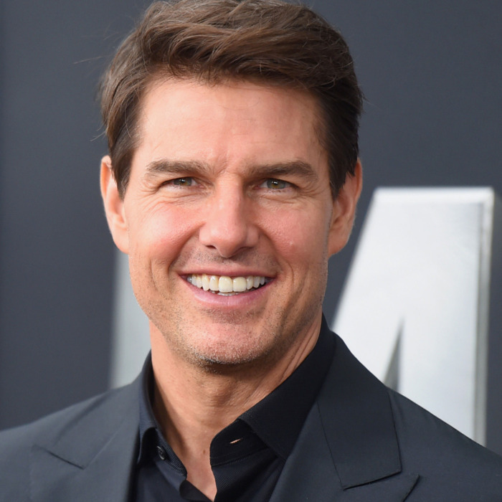
Hollywood Sign好萊塢標誌
Tom Cruise

Slide 3
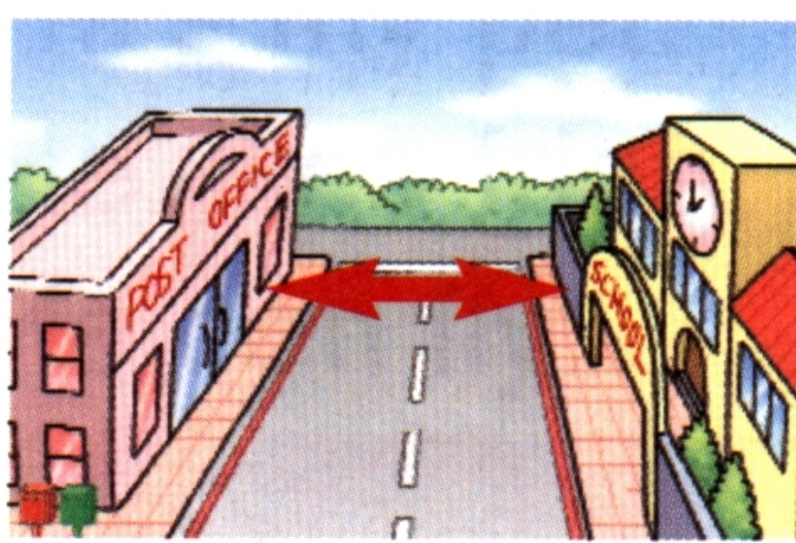
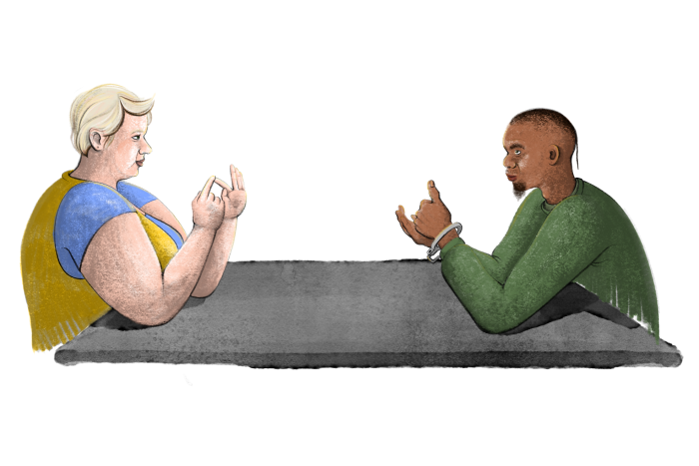
across from

Slide 4
between

Slide 5
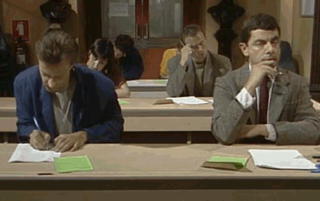
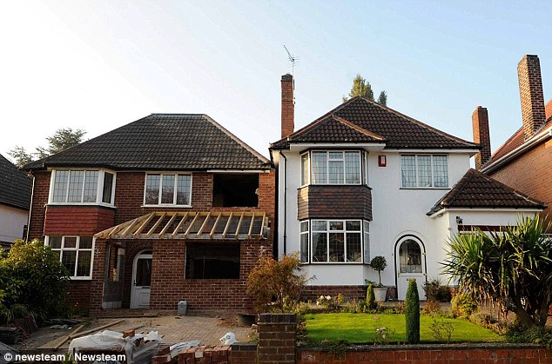
next to

Slide 6
department store
park
police station
MRT
station
sports center
school

Slide 7
Where is the police station?
Xinyi police District, Taipei City Police Department
It’s across from Taipei Xinyi Sports Center.

Slide 8
Where is the MRT station?
Taipei 101 / World Trade Center Exit 5
It’s next to Taipei 101 Department Store.

Slide 9
Is Xinyi Elementary School across from the park?
No, it’s not. It’s across from Taipei 101 / World Trade Center Station Exit 3.

Slide 10
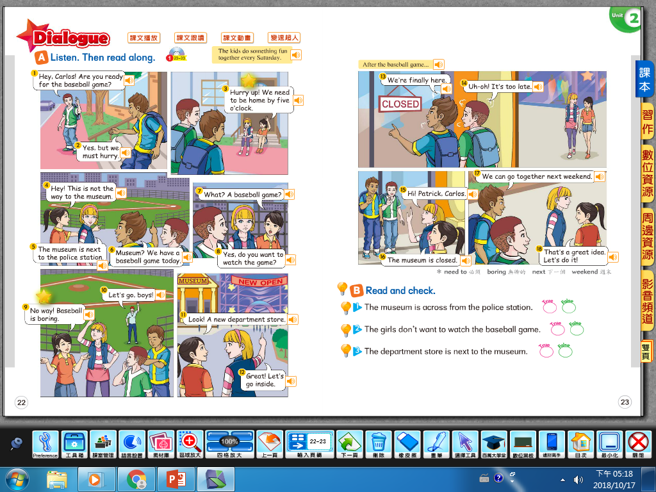

Slide 11
True or False?
1. The museum is across from the police station.
False! It’s next to the police station.

Slide 12
True or False?
2. The girls love to watch baseball games so much.
False! The girls think baseball games are boring.

Slide 13
3. Where are the girls?
They’re at the department store.

Slide 14
4. Where are they going to go next weekend?
They’re going to go to the museum next weekend.

Slide 15
5. How many roles we can know from the conversation?
6 roles. (Carlos/ Ella/ Patrick/ Judy/ a narrator/ a coach)

Slide 16
Copy the intonation of CD!

Slide 17
